Slide 1
Difficulty in creating symbolic model of fuel cell model with SCOTS

Slide 2
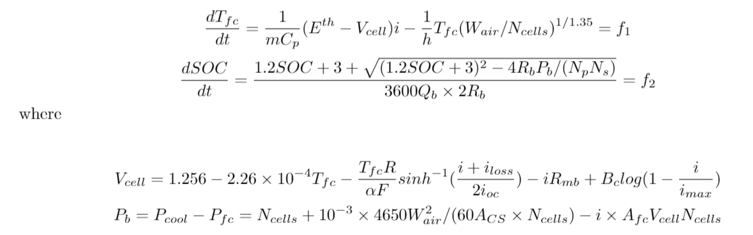
ODE I use for fuel cell model
Jason B. Siegel and Anna G. Stefanopoulou, “Cooling Parasitic Considerations for Optimal Sizing
and Power Split Strategy for Military Robot
Powered by Hydrogen Fuel Cells”

Slide 3

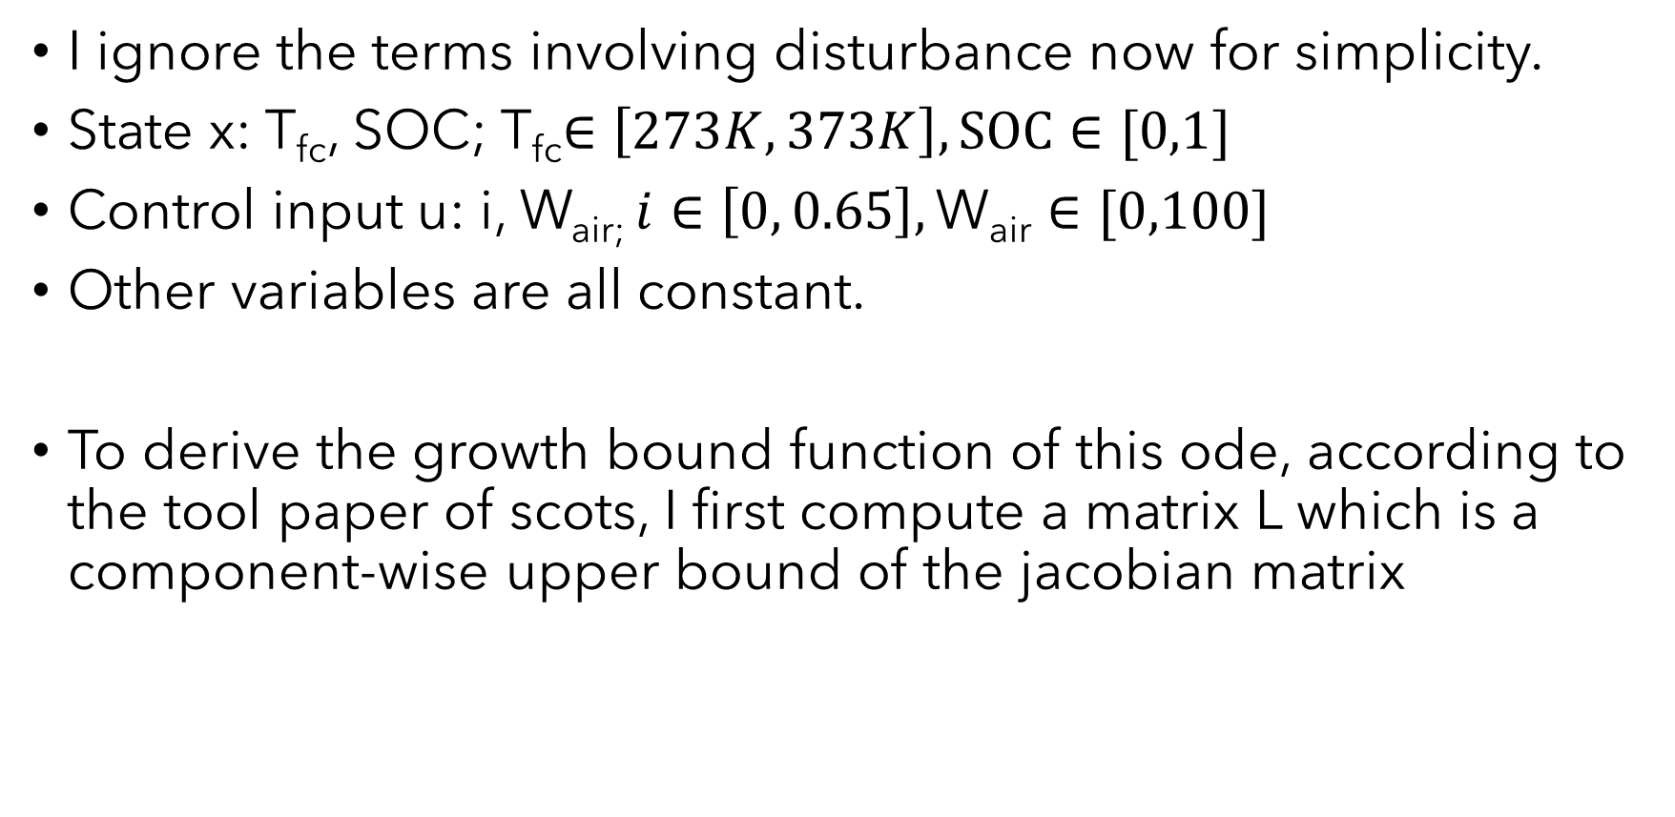
I ignore the terms involving disturbance now for simplicity.
State x: T_{fc}, SOC; T_{fc}$∈\left[273K, 373K\right], SOC∈[0,1]$
Control input u: i, W_{air;} $i∈\left[0, 0.65\right],\text{W}\text{air}∈[0,100]$
Other variables are all constant.
To derive the growth bound function of this ode, according to the tool paper of scots, I first compute a matrix L which is a component-wise upper bound of the jacobian matrix

Slide 4

One growth bound function is the solution to the following initial value problem:
Where r is the component-wise absolute value of the subtraction between any two state vectors in the domain where this growth bound function is valid.

Slide 5
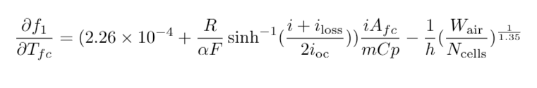


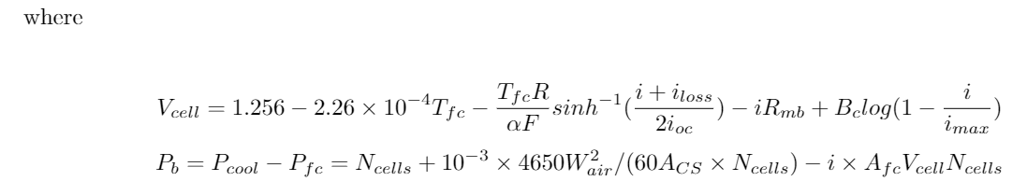

Slide 6

The formula for $\frac{∂f_{2}}{∂T_{fc}}$ and $\frac{∂f_{2}}{∂SOC}$ depend on state variables $T_{fc}$ and $SOC,$we should get rid of these two variables by finding the upper bound of them.

Slide 7

For this equation, things got too complex. I noticed that
is always positive, so I delete this term and only reserve

Slide 8
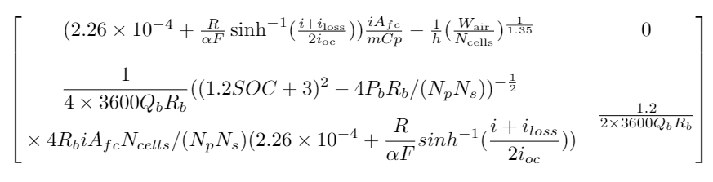
Then the matrix L will be:
T_{fc}=373K
SOC=0

Slide 9
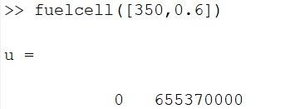
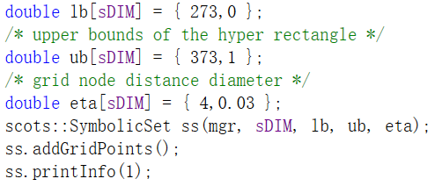
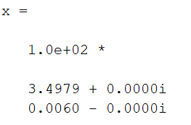
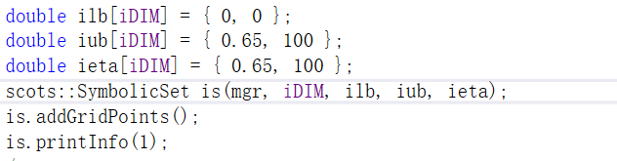
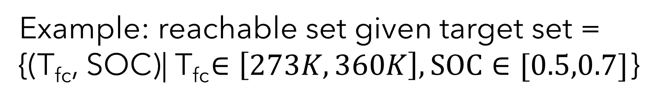
Example: reachable set given target set =
{(T_{fc}, SOC)| T_{fc}$∈\left[273K, 360K\right], SOC∈[0.5,0.7]$}
State space:
Control input space:

Slide 10
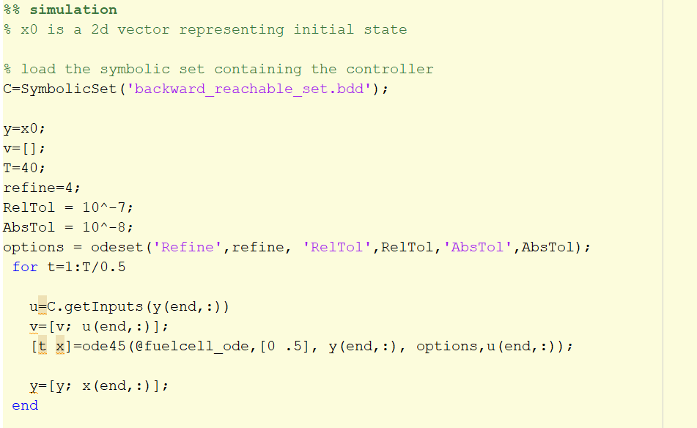
Codes in matlab

Slide 11
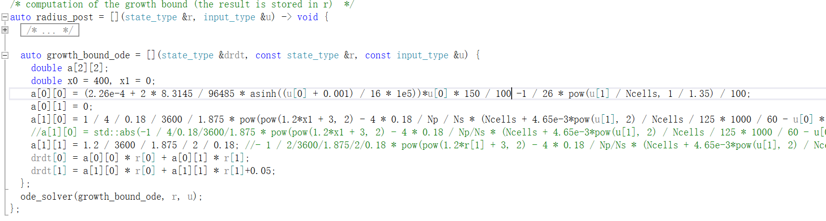
Codes in C++ computing the growth bound function

Slide 12
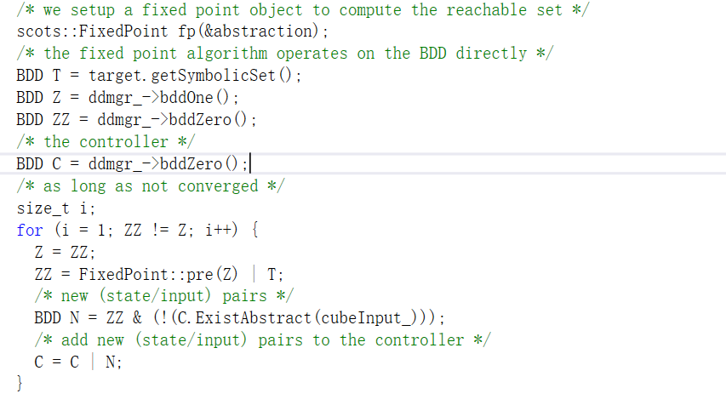
Codes in C++ computing the reachable set

